Slide 1
Test Driven Development In Action!
by Jon Kruger

Slide 2
What is Test Driven Development?
A software development technique where you write automated unit tests before you write your implementation code
A technique for ensuring good quality and good design
Awesome!

Slide 3
Example of a unit test
[TestFixture]
public class When_using_the_calculator
{
[Test]
public void Should_add_two_numbers()
{
int result = new Calculator().Add(2, 3);
result.ShouldEqual(5);
}
}

Slide 4
Unit Tests vs. Integration Tests
Unit tests:
Tests a small unit of functionality
Mock or “fake out” external dependencies (e.g. databases)
Run fast
Integration tests:
Test the whole system working together
Can run slow
Can be brittle

Slide 5
Unit Testing Frameworks
.NET
NUnit, MSTest, MBUnit, xUnit, MSpec
Java
JUnit……
Ruby
RSpec, Test::Unit, Shoulda

Slide 6
The TDD Process
Write a test (or tests) for something. Since you haven’t written the implementation code yet, the tests should fail.
Write just enough code to get the test to pass.
Move on or refactor
“Red – Green – Refactor”

Slide 7
A Series of Translations

Slide 8
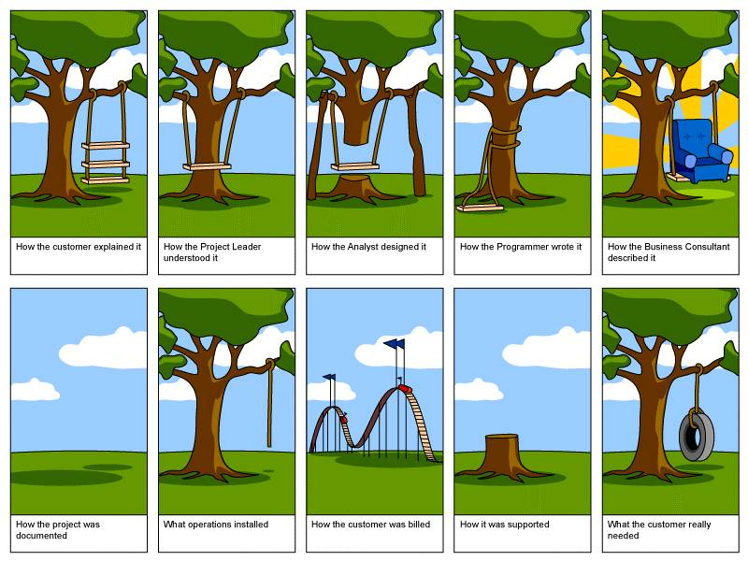

Slide 9
A Series of Translations

Slide 10
Code!

Slide 12
Case Studies
We don’t know what code is supposed to do
“The Legacy Codebase”

Slide 13
Case Studies
We can’t prove that our code is working without someone manually verifying that it works
“The Last Minute Change”

Slide 14
Case Studies
Bugs are a waste of time
“The Infinite Loop of Bugs”

Slide 15
Case Studies
Low standards of quality
“Throwing It Over the Wall”

Slide 16
Case Studies
Bugs can be really expensive to fix
“Explosions and Blackouts”

Slide 17
Case Studies
Over time, code bases tend to become more chaotic and painful to work with
“The Maintenance Nightmare”

Slide 18
How can we solve these problems?
We need a way to ensure that our code is working
We need a way to ensure that our code will continue to work after someone changes it
We need a way to figure out what code is supposed to do
We need to make software development less stressful

Slide 19
What’s in it for me?
Proof that your code works
Fewer bugs (both now and in the future)
Peace of mind

Slide 20
“Clean code that works is the goal of Test Driven Development.”
-- Ron Jeffries

Slide 21
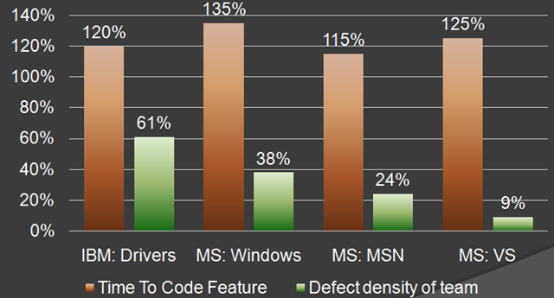
The Cost of Unit Testing
Source: http://blog.typemock.com/2009/03/cost-of-test-driven-development.html

Slide 22
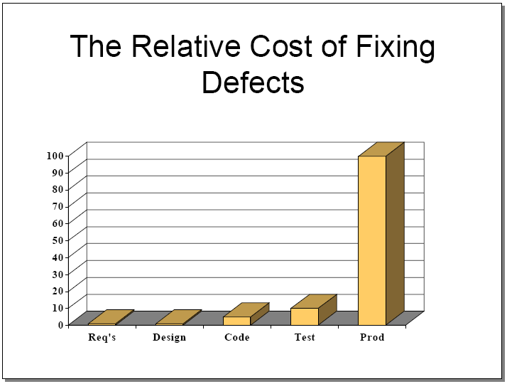
The Cost of Not Unit Testing
Source: http://www.riceconsulting.com/public_pdf/STBC-WM.pdf

Slide 23
“If I don't need to make it work, I can go a lot faster.”
-- Kent Beck

Slide 24
Behavior Driven Development
Testing the behavior of the system (not just data returned by a method)
Defining what it means for your system to work correctly (not just verifying that code works)
Notes:
Software development is a series of translations – we need to get from an idea in someone’s head to working software. The best way to not lose sight of that goal is to do small “translations” that will ensure that we stay focused on the original goal.

Slide 25
Evolution of a TDD test
Step 1: you get your technical specifications Money can be transferred from one back account to another.
What is really being said here?

Slide 26
Evolution of a TDD test
Step 2: translate the specs into acceptance criteria (what will it take to complete the feature?)
Precondition:
Given two bank accounts and the source account has money in it Action:
When transferring money from the source account to the destination account Postconditions:
Then the money should be deducted from the source account
Then the money should be added to the destination account

Slide 27
Evolution of a TDD test
Step 3: Write the acceptance criteria out as code

Slide 28
public class Given_two_BankAccounts_with_money_in_the_source_account : SpecBase
{
}
public class When_transferring_money_from_the_source_account_to_another_account
: Given_two_BankAccounts_with_money_in_the_source_account
{
[Test]
public void Then_the_money_should_be_subtracted_from_the_source_account()
{
}
[Test]
public void Then_the_money_should_be_added_to_the_destination_account()
{
}
}
We are translating actual business requirements into code that will verify that our code does what the business wants it to do.

Slide 29
public class Given_two_BankAccounts_with_money_in_the_source_account : SpecBase
{
protected BankAccount _fromAccount;
protected BankAccount _toAccount;
protected override void Establish_context()
{
_fromAccount = new BankAccount();
_fromAccount.Deposit(5);
_toAccount = new BankAccount();
}
}
public class When_transferring_money_to_another_account
: Given_two_BankAccounts_with_money_in_the_source_account
{
[Test]
public void Then_the_money_should_be_subtracted_from_the_source_account()
{
}
[Test]
public void Then_the_money_should_be_added_to_the_destination_account()
{
}
}

Slide 30
public class Given_two_BankAccounts_with_money_in_the_source_account : SpecBase
{
protected BankAccount _fromAccount;
protected BankAccount _toAccount;
protected override void Establish_context()
{
_fromAccount = new BankAccount();
_fromAccount.Deposit(5);
_toAccount = new BankAccount();
}
}
public class When_transferring_money_to_another_account
: Given_two_BankAccounts_with_money_in_the_source_account
{
protected override void Because_of()
{
_fromAccount.TransferMoneyTo(_toAccount, 3);
}
[Test]
public void Then_the_money_should_be_subtracted_from_the_source_account()
{
_fromAccount.Balance.ShouldEqual(2);
}
[Test]
public void Then_the_money_should_be_added_to_the_destination_account()
{
_toAccount.Balance.ShouldEqual(3);
}
}
ARRANGE
ACT
ASSERT
Notes:
Our test is designing the BankAccount class for us.

Slide 31
Evolution of a TDD test
Step 4: Run the tests and watch them fail
If your tests pass, then make sure that they’re written correctly. We’re checking for false positives.

Slide 32
Evolution of a TDD test
Step 5: Write just enough code to make the tests pass
public class BankAccount
{
public double Balance { get; private set; }
public void TransferMoneyTo(
BankAccount destinationAccount, double amount)
{
Balance -= amount;
destinationAccount.Deposit(amount);
}
}
Notes:
Notice that I’m not checking to see if destinationAccount is null and I’m not verifying that there is enough money in the destination account.

Slide 33
Evolution of a TDD test
Step 6: Run tests and watch them pass

Slide 34
Evolution of a TDD test
Step 7: Refactor (if necessary) or move on to the next thing!

Slide 35
Example of a “Test after” test
[TestFixture]
public class BankAccountTests
{
[Test]
public void TransferMoneyToTest()
{
var fromAccount = new BankAccount();
fromAccount.Deposit(5);
var toAccount = new BankAccount();
fromAccount.TransferMoneyTo(toAccount, 3);
Assert.That(fromAccount.Balance, Is.EqualTo(2));
Assert.That(toAccount.Balance, Is.EqualTo(3));
}
}
Class and method names don’t really tell us anything about the behavior of the system
Longer test methods are harder to read (and write)
Our tests didn’t drive the design of our code
We don’t have descriptive documentation of what our code does

Slide 36
Why is testing first better?
Concentrate on what the code is supposed to do (without worrying about implementation)
We don’t write more code than we need to write
We have a goal to shoot for
We know when we are done
We will write fewer bugs
You can’t cheat and blow off the tests
TDD helps design our code
We will write testable code
If you’re going to write tests, why not write them first?

Slide 37
BDD Tips and Guidelines
One test per idea
public class When_transferring_money_to_another_account
: Given_two_BankAccounts_with_money_in_the_source_account
{
public override void Because_of()
{
_fromAccount.TransferMoneyTo(_toAccount, 3);
}
[Test]
public void Then_the_money_should_be_subtracted_from_the_source_account()
{
_fromAccount.Balance.ShouldEqual(2);
}
[Test]
public void Then_the_money_should_be_added_to_the_destination_account()
{
_toAccount.Balance.ShouldEqual(3);
}
}
Notes:
Often times, this means that you have one assertion per test.

Slide 38
BDD Tips and Guidelines
One test per idea
public class When_displaying_bank_account_information
: SpecBase<BankAccountController>
{
[Test]
public void Then_the_bank_account_details_should_be_displayed()
{
_viewModel.AccountNumber.ShouldEqual(“9723742893”);
_viewModel.AccountHolder.ShouldEqual(“Joe Smith”);
_viewModel.AccountStatus.ShouldEqual(“Active”);
_viewModel.Balance.ShouldEqual(2);
}
}
Notes:
Sometimes it just makes more sense to have more than one assertion per test.
One assertion per test in this case would take longer and would end up being harder to read
Use common sense

Slide 39
BDD Tips and Guidelines
Use Should____() extension methods, for example:
ShouldEqual()
ShouldNotEqual()
ShouldBeTheSameAs() (reference comparison)
ShouldContain()
ShouldNotContain()
ShouldBeNull()
ShouldNotBeNull()
ShouldBeTrue()
ShouldBeFalse()
ShouldBeGreaterThan()
ShouldBeThrownBy()
Write your own!

Slide 40
Tips for learning TDD
Be patient. You will get better/faster at this.
Resist the urge to cheat
Clean code, not clever code “Clean code that works is the goal of Test Driven Development.”
Notes:
You are here to learn. When you are working on learning something, it will take longer, but you get better at it over time. The goal of this time is give you a chance to practice so that you feel comfortable enough doing TDD on real projects.
-Fewer lines of code != better code. We want to reduce duplication, of course, but “fewer lines of code” does not mean that you have a better solution.
-Write code that is easy to read, change, and understand
We’re not trying to solve geek puzzle problems here

Slide 41
Greed is a dice game where you roll five six-sided dice to accumulate
points. The following "score" function will be used calculate the
score of a single roll of the dice.
A greed roll is scored as follows:
* A set of three ones is 1000 points
* A set of three numbers (other than ones) is worth 100 times the
number. (e.g. three fives is 500 points).
* A one (that is not part of a set of three) is worth 100 points.
* A five (that is not part of a set of three) is worth 50 points.
* Everything else is worth 0 points.
Examples:
score([1,1,1,5,1]) => 1150 points
score([2,3,4,6,2]) => 0 points
score([3,4,5,3,3]) => 350 points
score([1,5,1,2,4]) => 250 points
Your goal is to write the score method.

